Slide 1
The Bayesian T-Shirts (a taste of optimal inventory)
Raman A. Shah, Ph.D.
PyData Chicago
23 February 2023

Slide 2
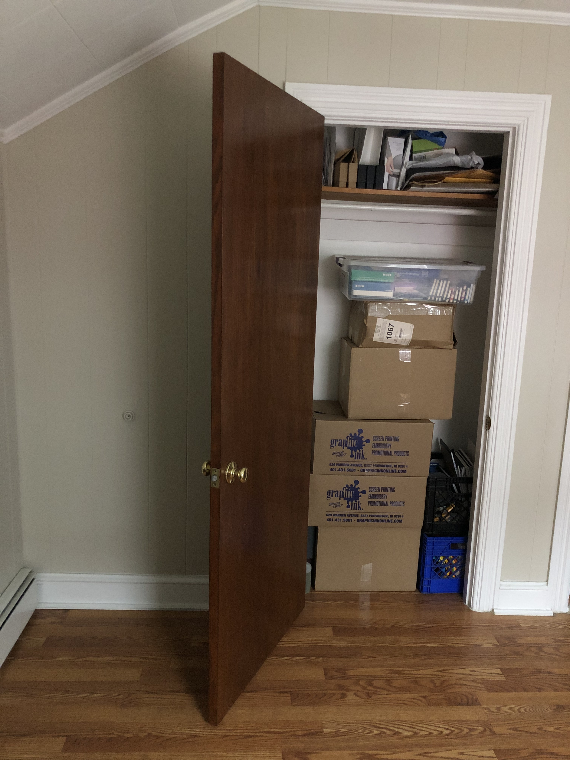
Inventories are everywhere!

Slide 3
The decision we’re making
There are 12 t-shirt sizes to keep in stock:
XS to XXXL (7 sizes) in a men’s/unisex cut
S to XXL (5 sizes) in a women’s cut
It’s time to ask the screen printing shop for our next box of (35) shirts.
We have leftover inventory and owe people back-ordered shirts.
How many of each size should we ask for?

Slide 4
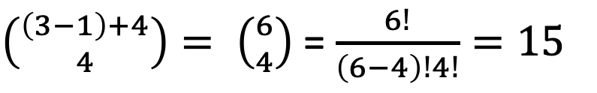
Stars and Bars counts the decision space
How many possible orders are there for a box of 4 shirts that come in 3 sizes?
0 of size A
1 of size B
3 of size C
$\left({\left(3−1\right)+4 \atop 4}\right)= \left({6 \atop 4}\right)$ = $\frac{6!}{\left(6−4\right)!4!}=15$
>>> scipy.special.binom(6, 4)
15.0

Slide 5
Stars and Bars counts the decision space
How many possible orders are there for a box of 35 shirts that come in 12 sizes?
$\left({\left(12−1\right)+35 \atop 35}\right)= \left({46 \atop 35}\right)$ = $\frac{46!}{\left(46−35\right)!35!}=13,340,783,196$
>>> scipy.special.binom(46, 35)
13340783196.0

Slide 6
Choosing a “best” order is tricky
What orders should we expect in the future?
Does the future even resemble the past?
A t-shirt wholesaler can advise us on the size distribution for the general population. At the beginning, we have little experience with our own population (which may be different from the general population). Is there a way to use this knowledge but let it “fade out” over time, as we gain experience?
How do we define “best,” and how do we compute it?
We want a full wallet and an airy closet – but for a worst-case sequence of future orders? A typical case? Something else? What’s the balance of pain points (wasting cash, getting cramped on space, not having inventory when you need it)?
Brute-forcing 13.3B of any significant computation is unpalatable.

Slide 7

The mundane part: openpyxl
Putting advanced inventory optimization into practice generally involves integrating our (PyData) goodies with an existing Enterprise Resource Planning (ERP) system.
When the inventory fits in two cardboard boxes, the ERP is probably going to be a Microsoft Excel workbook.
And when it doesn’t...Excel (in human hands) is often still the bridge between the ERP and an advanced quantitative solution.

Slide 8
Inventory policy #1: prepare for the worst
Pessimistically: what if we don’t understand the demand at all? Forget statistics: if we have 4 of everything, we’re guaranteed 4 orders of supply.
Fill up the holes in inventory and spread the rest evenly, breaking ties to favoring the most popular sizes.
Math level: counting and common sense.
There are applications where this is the right thing to do! (First aid kits!)
 | MXS | MS | MM | ML | MXL | M2XL | M3XL | WS | WM | WL | WXL | W2XL
Before | 1 | -1 | -1 | 5 | 3 | 2 | 1 | 3 | 0 | 3 | 0 | 0
Policy #1 Order | 3 | 5 | 6 | 0 | 1 | 2 | 3 | 1 | 5 | 1 | 4 | 4
After | 4 | 4 | 5 | 5 | 4 | 4 | 4 | 4 | 5 | 4 | 4 | 4

Slide 9
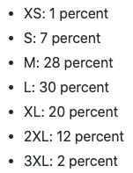
Inventory policy #2: take industry advice
A reasonable idea: stock what the industry suggests.
Make sure we have one of everything, then one at a time, add shirts where we are the farthest below the recommended industry proportions.
Math level: analyst with Excel.
 | MXS | MS | MM | ML | MXL | M2XL | M3XL | WS | WM | WL | WXL | W2XL
Before | 1 | -1 | -1 | 5 | 3 | 2 | 1 | 3 | 0 | 3 | 0 | 0
Policy #2 Order | 0 | 3 | 8 | 2 | 2 | 1 | 0 | 0 | 7 | 4 | 5 | 3
After | 1 | 2 | 7 | 7 | 5 | 3 | 1 | 3 | 7 | 7 | 5 | 3
Source: The Adair Group, https://www.theadairgroup.com/blog/2020/06/01/shirt-order-size-distribution-what-sizes-to-order-for-t-shirts/

Slide 10
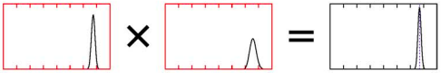
Employ a Bayesian (generative) attitude
prior
likelihood
posterior
Define a “prior” distribution of possible universes (possible streams of t-shirt orders)
Simulate those universes, weighting them by how consistent they are with our data (the actual order history)
Do whatever we want with our “posterior” simulated universes (e.g., testing how a given t-shirt order performs in it)

Slide 11
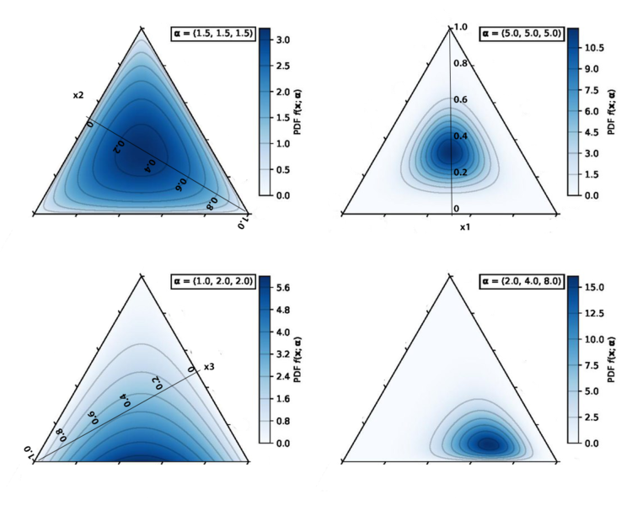
The Dirichlet distribution of universes
Like a histogram of histograms
“Exponential family” – if you start with a Dirichlet(1.5, 1.5, 1.5) prior and get 1, 2, and 3 orders, you end with a Dirichlet(2.5, 3.5, 4.5) posterior
We implement the industry advice within a weakly informative Dirichlet prior

Slide 12
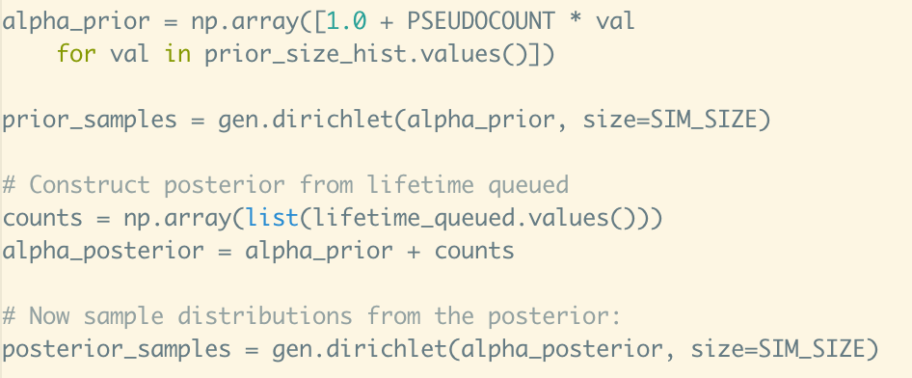
Closed-form exponential-family Bayesian inference in the PyData stack is delightful

Slide 13
Inventory policy #3: posterior + heuristic
For the stream of orders in each universe:
Pretend we just didn’t do a re-order.
Work through what comes in, satisfying orders out of inventory when possible, until there are 35 back-orders.
Those 35 back-orders comprise the optimal order for that specific universe.
Average the counts over universes (massaging the decimals).
Math level: Python data scientist feeling normal.
 | MXS | MS | MM | ML | MXL | M2XL | M3XL | WS | WM | WL | WXL | W2XL
Before | 1 | -1 | -1 | 5 | 3 | 2 | 1 | 3 | 0 | 3 | 0 | 0
Policy #3 Order | 0 | 4 | 10 | 3 | 1 | 1 | 1 | 0 | 6 | 2 | 4 | 3
After | 1 | 3 | 9 | 8 | 4 | 3 | 2 | 3 | 6 | 5 | 4 | 3

Slide 14
Inventory policy #4: brute-force tweaks
Knock down the 13.3B choices to the few thousand within two edits of the solution to policy #3. No hard guarantee of a global optimum, but chances are decent.
Math level: Python data scientist feeling stressed out: NumPy shape management, making memory/CPU tradeoffs, thinking carefully about vectorization to get acceptable performance, etc.
 | MXS | MS | MM | ML | MXL | M2XL | M3XL | WS | WM | WL | WXL | W2XL
Before | 1 | -1 | -1 | 5 | 3 | 2 | 1 | 3 | 0 | 3 | 0 | 0
Policy #4 Order | 1 | 4 | 9 | 2 | 1 | 1 | 1 | 0 | 6 | 2 | 5 | 3
After | 2 | 3 | 8 | 7 | 4 | 3 | 2 | 3 | 6 | 5 | 5 | 3

Slide 15
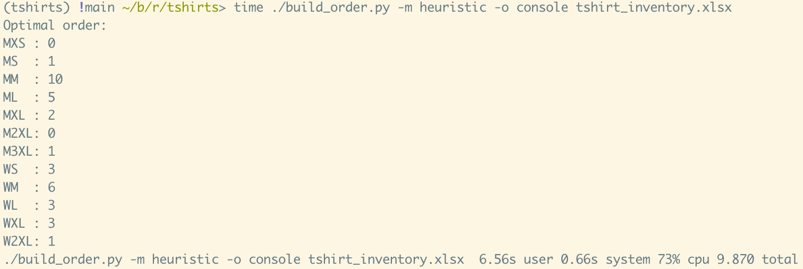
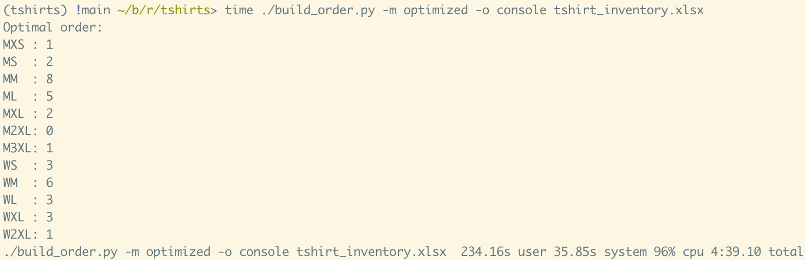
Discrete optimization is hard! (NP-Hard!)
Policy #3:
6.56 s
Policy #4:
234.16 s

Slide 16
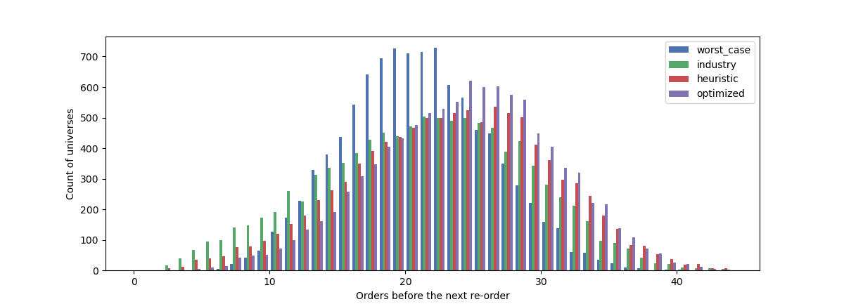
But it helps!

Slide 17

Future work: hierarchical models in PyMC
The Dirichlet distribution treats all 12 sizes on an equal footing, but that isn’t quite right:
If we see few women’s M and women’s L orders, that says something about the gender ratio in our population
That should influence how many women’s S and women’s XXL orders we’d expect, even if we’ve never seen one
The posterior for this “hierarchical model” requires sophisticated numerical (Hamiltonian Monte Carlo) algorithms

Slide 18
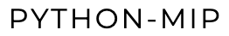
Future work: integer programming in python-mip
Integer programming is like linear programming, but constraining variables and constraints to be integers (which makes everything much worse).
Still working on an NP-Hard problem, so it will never be trivially fast - but there’s a whole field around re-writing optimization problems in standard forms and developing engines that are as efficient as possible.
Not clear to me yet: Can the Bayesian posterior reasonably be expressed within an integer program?

Slide 19


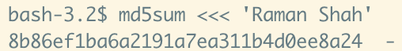
Thanks!
Get in touch
@rs_datascience
https://linkedin.com/in/ramanshah
Review the project repo
https://github.com/ramanshahdatascience/tshirts
Win a shirt if your name’s MD5 hash starts with 0

